Slide 1

RASPBERRY PI
By Thushar Tom

Slide 2
What is a Raspberry pi?
The Raspberry Pi is a low cost, credit-card sized computer that plugs into a computer monitor or TV, and uses a standard keyboard and mouse.
How is it different from an arduino?
The main difference between them is Arduino is microcontroller board while raspberry pi is a mini computer.
Notes:
Arduino is just a part of raspberry pi.Raspberry Pi is good at software applications, while Arduino makes hardware projects simple.
Both can basically be used to interface sensors, actuators etc.
Projects- Ideal for computing processes that last long even on backup power, as rasp works on really low power.
Local servers, and movie downloads(Explain the fun part)

Slide 3
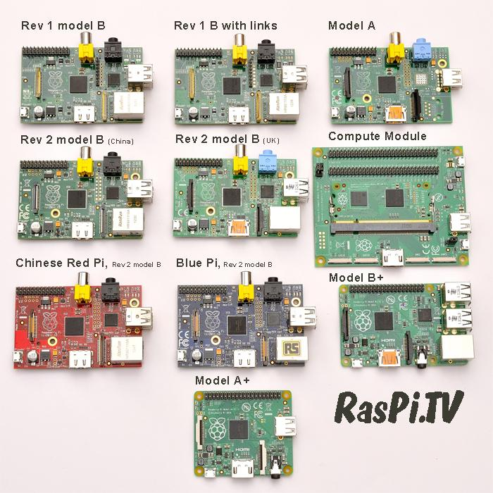
Different types of Pi
If you wanna know more about them Log onto https://www.raspberrypi.org/
Updates, News, Creative Projects, Support Libraries relating to raspberry pi are available

Slide 4
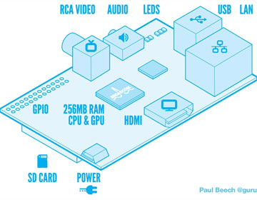
Different parts of Pi 3 Model B+
40 GPIO- General purpose I/O
ARM CPU/GPU- Quad core
RCA- Allows connection of analog TV
Audio Out
LED’s
USB
HDMI
Power - 5V (2A preferred)
SD card slot - 8-32GB
Ethernet
Notes:
Only diff between Model A and B is that B is more Costly and has Ethernet port and an extra USB port

Slide 5
Booting up
OS - RASPBIAN

Slide 6
BOOTING UP
THERE ARE TWO WAYS
With NOOBS (New Out of the Box Software) Installer
Normal linux distro bootable

Slide 7
INSTALLING WITH NOOBS
Download NOOBS installation files from https://www.raspberrypi.org/downloads/raspbian/
Follow the instructions on the raspberry pi documentation page
https://projects.raspberrypi.org/en/projects/raspberry-pi-setting-up/3

Slide 8
INSTALLING WITHOUT NOOBS
Download raspbian from
https://www.raspberrypi.org/downloads/raspbian/
Then follow instructions from
https://www.raspberrypi.org/documentation/installation/installing-images/README.md

Slide 9
Who needs a fully wired raspberry pi with monitor, keyboard and a mouse the whole time.

Slide 10

REMOTE ACCESS Enable remote access - sudo raspi-config
SSH and VNC
Connect to a common network
Terminal command- sudo ifconfig
Open VNC chrome extension and type in the ip address

Slide 11
Navigating through linux commands.
Commands
Expansion
Description
pwd
Cd
Cd~
Cd ..
ls
mkdir
Sudo
Wget
Rm -r
Print working directory
Change directory
Change directory
Change directory
List
Make directory
Super user do
Web get
Remove recursively
.
Prints the current directory
It lets you change your current directory
Go back to the root
Go back a single directory
List the things in a directory
Make a directory for you
Give the Root user authorisation
Helps to download files
Helps to remove a directory
Notes:
Most of the things we do on pi are fortunately already done on pi by someone else. So the task it to find that “someone else” and they will help us find a solution to the problem we are facing.
Most of the code is gonna be copied ...ctrl+ c for copy and ctrl+ shift+ v for pasting in terminal.
Use up arrow to take the last command
Never Copy The Dollar sign.

Slide 12
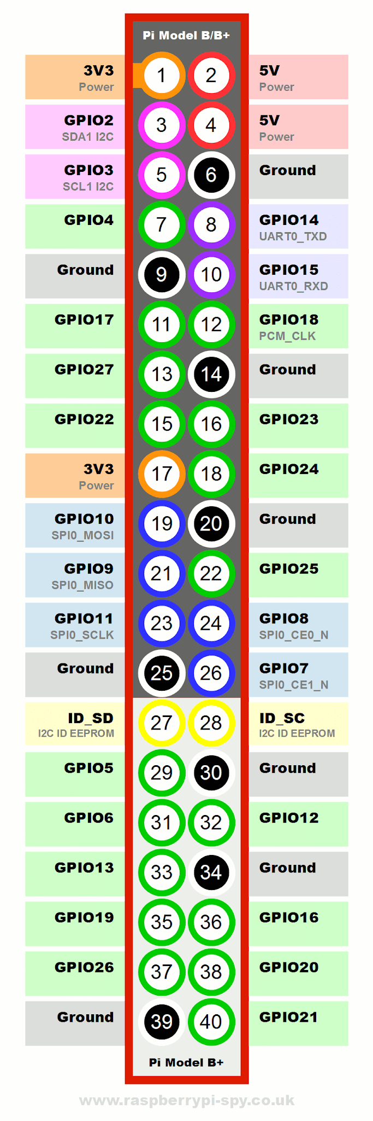
GPIO Pinout
Lets see if we can blink an led with this.
Sudo idle
Make all the necessary connections on a breadboard
Run the code
See the magic happen
Be Very careful when you use GPIO pins because VCC and Ground pins are really close and more current drawn from the Raspberry pi may cause it to fail

Slide 13
Interfacing Pi-Camera
Sudo raspi-config -- Enable Picam
Sudo nano picamtest.py
Sudo apt-get install python-picamera
Sudo apt-get install python3-picamera
Python picam

Slide 14

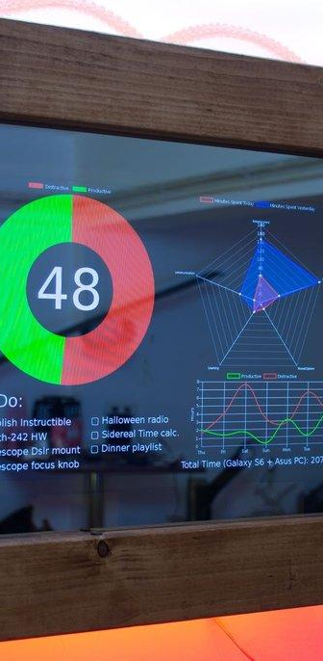
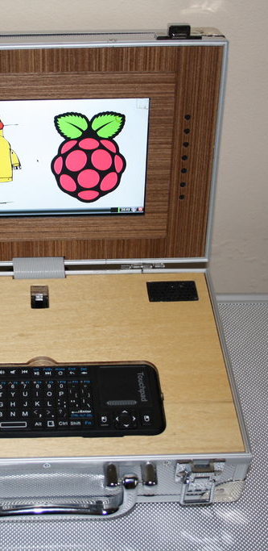

Projects

Slide 15

Contact
Thushar Tom
RAS SECRETARY
IEEE SB CEC
thushartom@ieee.org

